Slide 1


Chapter 1
LAN Design

Slide 2
Note for Instructors
These presentations are the result of a collaboration among the instructors at St. Clair College in Windsor, Ontario.
Thanks must go out to Rick Graziani of Cabrillo College. His material and additional information was used as a reference in their creation.
If anyone finds any errors or omissions, please let me know at:
  tdame@stclaircollege.ca.

Slide 3
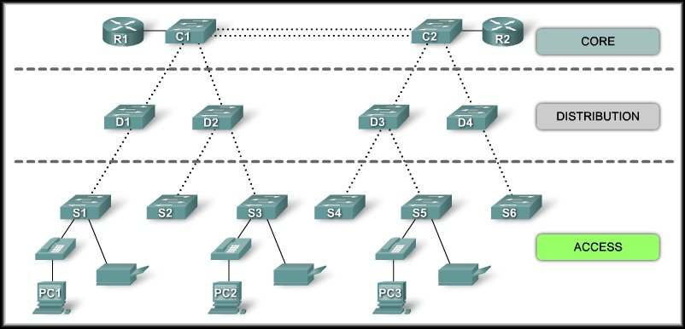
LAN Design
Switched LAN Architecture

Slide 4
Switched LAN Architecture
When building a LAN that satisfies the needs of a small or medium-sized business, your plan is more likely to be successful if a hierarchical design model is used.
  Divided into discrete layers.
  Each layer has a specific purpose.
  Becomes modular – maintenance, performance.

Slide 5
Switched LAN Architecture

Slide 6
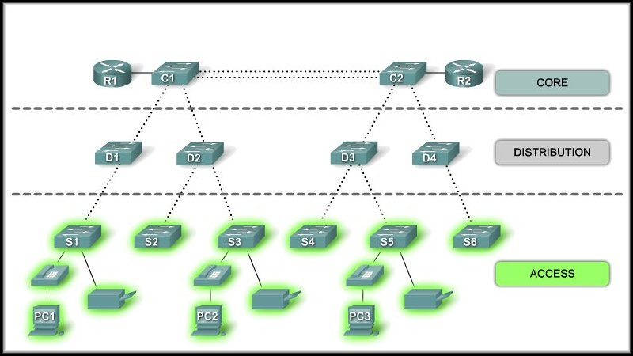
Access Layer
Interfaces with end devices.
Routers, switches, bridges, wireless access points.
    Provides a means of connecting and controlling which devices are allowed to communicate on the network.

Slide 7
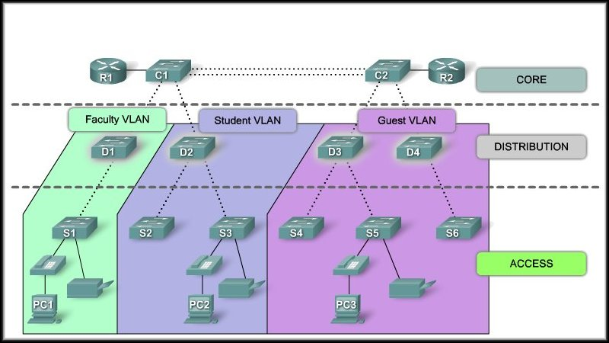
Distribution Layer
Aggregates (funnels) Access Layer traffic.
Controls traffic flow with security or routing policies.
Defines broadcast domains.
    Routing of VLANs (Virtual LANs).

Slide 8
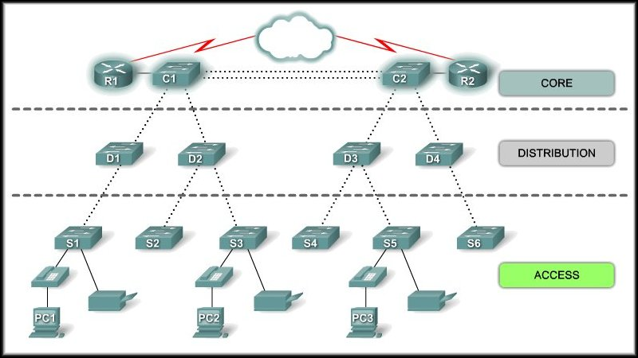
Core Layer
High speed backbone of the network.
Must be highly available and redundant.
    Must be capable of quickly forwarding large amounts of data.
    Smaller networks – collapsed model (Core and Distribution).

Slide 9
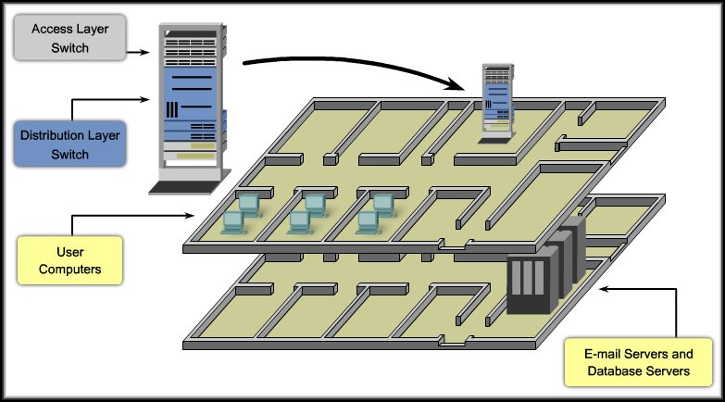
Medium Sized Business
Logical Layout
Physical
Layout

Slide 10
Benefits of a Hierarchical Network
Benefits:
  Scalability
  Redundancy
  Performance
  Security
  Manageability
  Maintainability

Slide 11
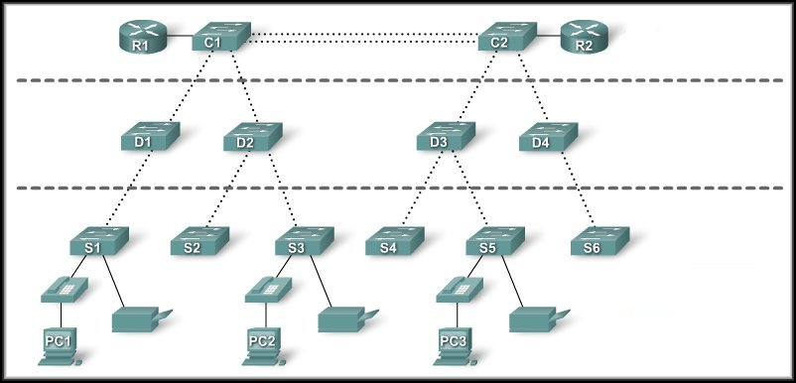
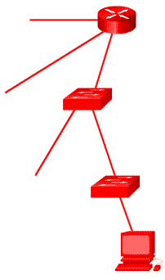
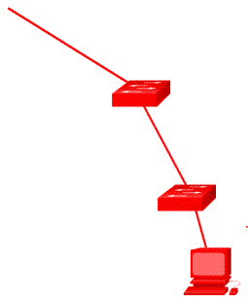

Benefits of a Hierarchical Network
Scalability
Hierarchical Networks can be expanded easily.

Slide 12
Benefits of a Hierarchical Network
Redundancy
Redundancy at the core and distribution layers ensure availability.

Slide 13




Benefits of a Hierarchical Network
Performance
Link aggregation and high performance distribution and core layer switches provide near-wire speed at all layers.

Slide 14




Benefits of a Hierarchical Network
Security
Port security at the access layer and policies at the distribution layer make the network more secure.

Slide 15
Benefits of a Hierarchical Network
Manageability
Configurations
Additional Switch
Functionality
Rapid Recovery
Easier Troubleshooting
Consistency among switches at each layer makes management more simple.

Slide 16





Benefits of a Hierarchical Network
Maintainability
The modular design allows a network to scale easily without becoming over-complicated or burdensome.

Slide 17
Principles of Hierarchical Network Design
Just because a network is hierarchical, it doesn’t mean it’s well designed.
  Network Diameter:
    The number of devices that a packet has to cross before it reaches its destination.
  Bandwidth Aggregation:
    After the bandwidth requirements of the network are known, links between specific switches can be aggregated or combined to provide higher bandwidth.
  Redundancy:
    The practice of providing multiple paths to a destination or multiple instances of a device.

Slide 18
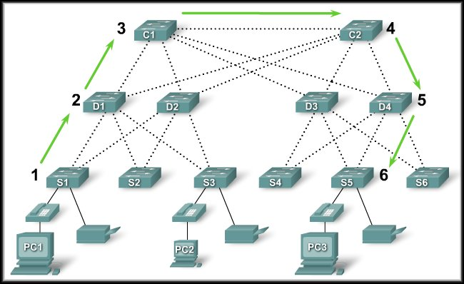
Principles of Hierarchical Network Design
More on this in Chapter 5
Network Diameter:
  For PC1 to
  communicate
  with PC3, the
  data must
  traverse 6
  intermediate
  switches.
  In this case, the network diameter is 6.
  Each switch introduces some latency.
  In a hierarchical network, network diameter is always going to be a predictable number of hops between the source and destination devices.

Slide 19
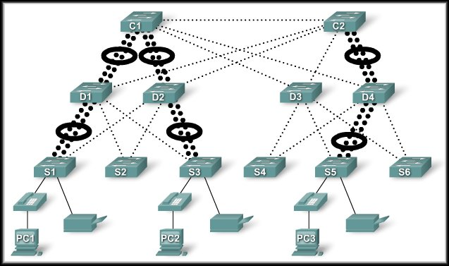
Principles of Hierarchical Network Design
Bandwidth
Aggregation:
  Link
  aggregation
  allows multiple
  switch port
  links to be
  combined so
  as to achieve higher throughput between switches.
  The determining factor is using link aggregation is the requirements of the user applications.

Slide 20
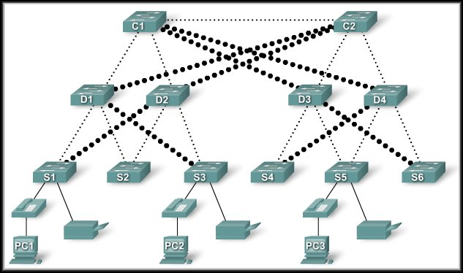
Principles of Hierarchical Network Design
Redundancy:
  Redundancy is
  one part of
  creating a
  highly available
  network.
  Multiple links
  between
  switches or multiple devices.
  It can get expensive and most likely will not be done on the access layer because of the cost and variety of devices.
  It is feasible at the distribution and core layers.

Slide 21
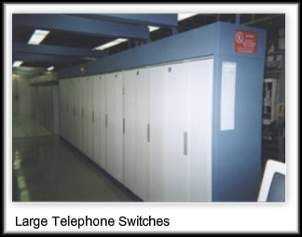
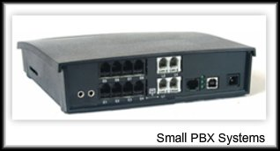
What is a Converged Network?
A Converged Network is one where voice and video communications have been combined on a single data network.
  Legacy Equipment:
    Until now, mainly feasible on large enterprise networks.

Slide 22
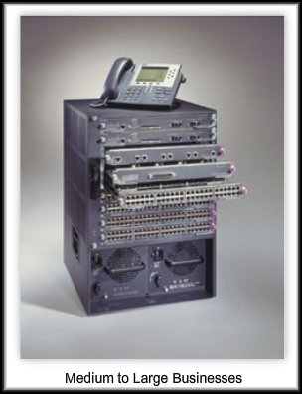

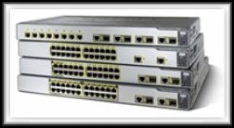
What is a Converged Network?
Advanced Technology:
  More popular to medium and small sized businesses.
  Can be a difficult decision considering current investments in technology.
  Benefit:
    Only one network to manage.

Slide 23


What is a Converged Network?
New Options:
  You can now tie voice and video communications directly into an employee's personal computer system.
  Software integrated on a PC eliminates an expensive handset.
  Add a webcam and video conference.

Slide 24
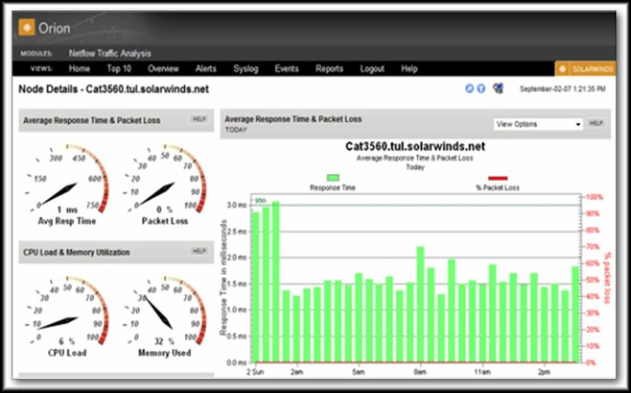
LAN Design
Matching Switches to
Specific LAN Functions
Traffic Flow Analysis
User Community Analysis
Data Stores and Data Servers Analysis
Topology Diagrams
Switch Features

Slide 25
Considerations for Network Switches
Traffic Flow Analysis:
  The process of
  measuring the
  bandwidth usage
  on a network and
  analyzing the data.
    Performance tuning.
    Capacity planning.
    Hardware improvement decisions.

Slide 26
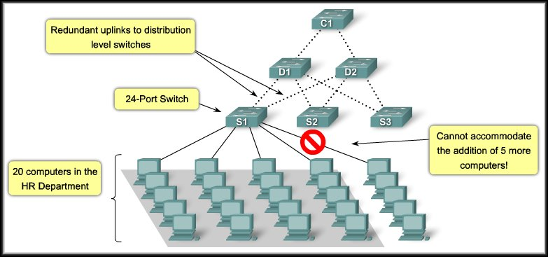
Considerations for Network Switches
User Community Analysis:
  The process of identifying various groupings of users and their impact on network performance.

Slide 27
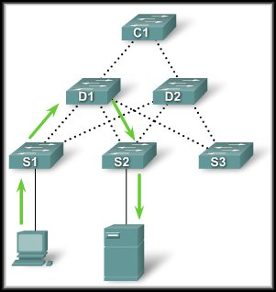
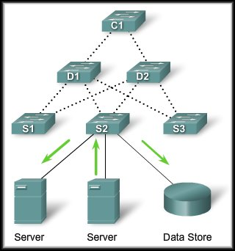
Considerations for Network Switches
Data Stores and Data Servers Analysis:
  When analyzing traffic on a network, consider the location of the data stores and data servers.
  Consider both client-server and server-server traffic.

Slide 28
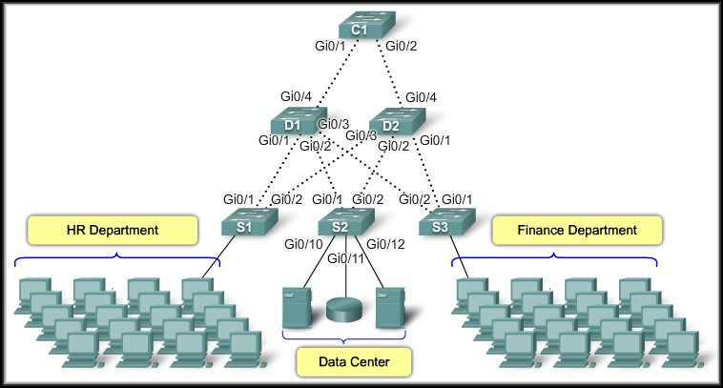
Considerations for Network Switches
Topology Diagram:
  A graphical representation of a network infrastructure.
    Switch connections with port numbers.
    Aggregated ports and redundant paths.
    Identify configuration by switch name.
    Could contain user information.

Slide 29
Switch Features
Switch Form Factors:
  When selecting a switch, you need to decide between
    Fixed configuration or modular configuration.
    Stackable or non-stackable.
  The switch form factor (physical size) is important depending upon where the switch will be installed.
    Wiring closet with limited space.
    Computer room with free standing racks.
    Shelf in a central area.

Slide 30
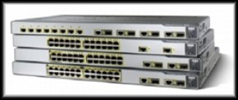
Switch Features
Fixed Configuration Switches:
  Fixed in their configuration.
  You cannot add features or options to the switch beyond those that originally came with the switch.

Slide 31
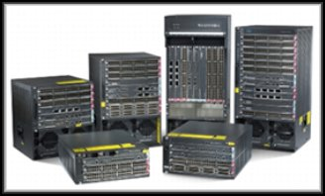
Switch Features
Modular Switches:
  Offer more flexibility.
  Typically come with different sized chassis that allow for the installation of different numbers of modular line cards.
  The line cards actually contain the ports.

Slide 32
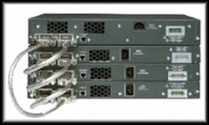
Switch Features
Stackable Switches:
  Interconnected using a special backplane cable that provides high-bandwidth throughput between the switches (Cisco StackWise).
  The stacked switches effectively operate as a single, larger switch.
  Desirable when fault tolerance and bandwidth availability are critical and a modular switch is too costly to implement.

Slide 33
Switch Performance
When selecting a switch for the access, distribution, or core layer, consider the ability of the switch to support:
  Port Density.
  Forwarding Rate.
  Bandwidth Aggregation Requirements.

Slide 34
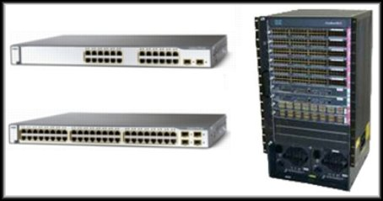
Switch Performance
Port Density:
  Port density is the number of ports available on a single switch.
24 Port
48 Port
Very high density.
Catalyst 6500 - 1,000 Ports

Slide 35

Switch Performance
Forwarding Rate:
  Defines the processing capabilities of a switch by rating how much data the switch can process per second.
  If the switch forwarding rate is too low, it cannot accommodate full wire-speed communication across all of its switch ports.
      A 48 port Gigabit switch is capable of switching 48 Gigabits of traffic.

Slide 36
Switch Performance
Forwarding Rate:
  Access layer switches typically do not need to operate at full wire speed because they are physically limited by their uplinks to the distribution layer.
  Allows the use of:
    Less expensive, lower performing switches at the access layer.
    More expensive, higher performing switches at the distribution and core layers, where the forwarding rate makes a bigger difference.

Slide 37

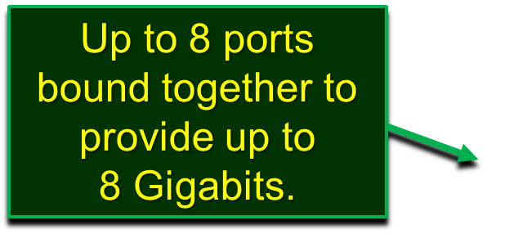
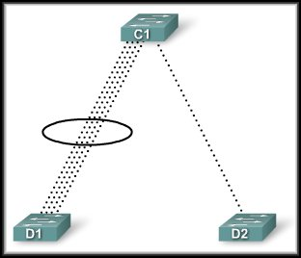

Switch Performance
Link Aggregation:
  As part of bandwidth aggregation, you should determine if there are enough ports on a switch to aggregate to support the required bandwidth.

Slide 38
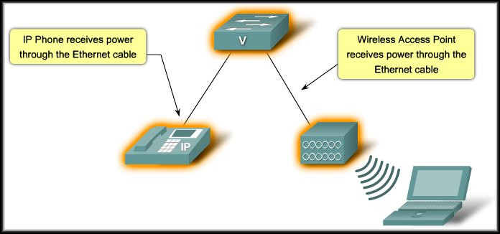
Switch Performance
Power over Ethernet (PoE):
  Allows the switch to deliver power to a device over the existing Ethernet cabling.
Adds considerable cost to the switch.

Slide 39
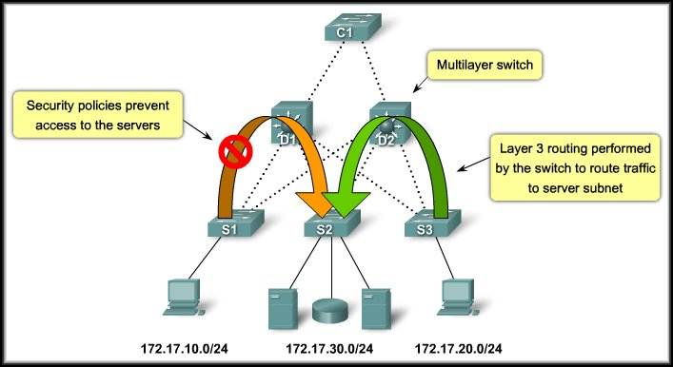
Switch Performance
Layer 3 Functionality:
  Switches typically operate at Layer 2 of the OSI Model.

Slide 40
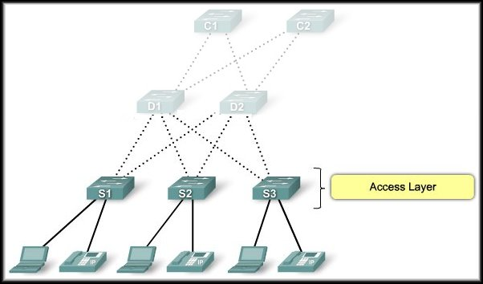
Switch Features – Hierarchical Network
Access Layer Switch Features:
Port Security
Link Aggregation
VLANs
FastEthernet/Gigabit
PoE
Quality of Service (QoS)

Slide 41
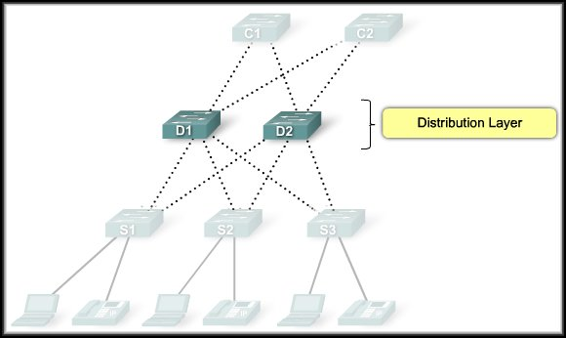
Switch Features – Hierarchical Network
Distribution Layer Switch Features:
Layer 3 Support
Link Aggregation
High Forwarding Rate
Gigabit/10 Gigabit
Redundant Components
Quality of Service (QoS)
Security Policies

Slide 42
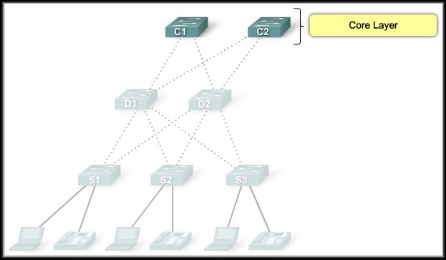
Switch Features – Hierarchical Network
Core Layer Switch Features:
Layer 3 Support
Link Aggregation
Very High Forwarding Rate
Gigabit/10 Gigabit
Redundant Components
Quality of Service (QoS)

Slide 43
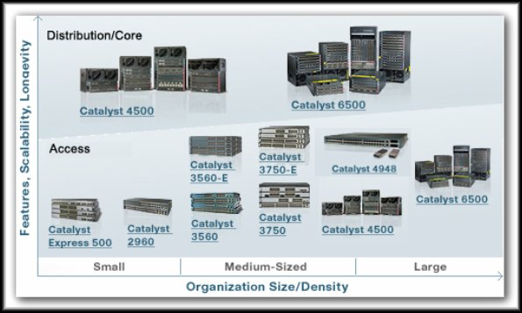
Switches – Small and Medium Business (SMB)
Cisco has seven switch product lines. Each product line offers different characteristics and features, allowing you to find the right switch to meet the functional requirements of your network.
The Cisco switch product lines are:
  Catalyst Express 500
  Catalyst 2960
  Catalyst 3560
  Catalyst 3750
  Catalyst 4500
  Catalyst 4900
  Catalyst 6500
Please refer to the text or online curriculum for details on each model.

Slide 44
Switches – Small and Medium Business (SMB)
Summary
 | Access | Distribution | Core
Bandwidth (Link) Aggregation
FastEthernet/Gigabit Ethernet
Gigabit Ethernet/10 Gigabit Ethernet
High Forwarding Rate
Layer 3 Support
Port Security
Power Over Ethernet (PoE)
Quality of Service (QoS)
Redundant Components
Security Policies/Access Control Lists
Very High Forwarding Rate
VLANs
u
u
u
u
u
u
u
u
u
u
u
u
u
u
u
u
u
u
u

